Slide 1

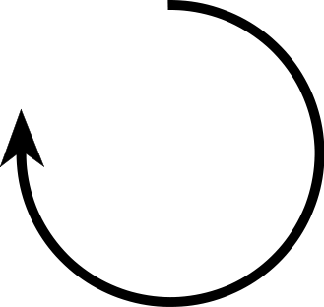

Geometric Transformations
2D and 3D

Slide 2
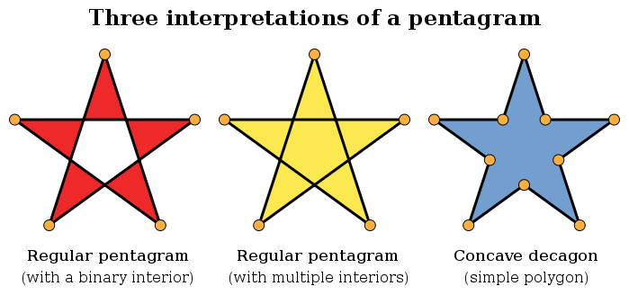
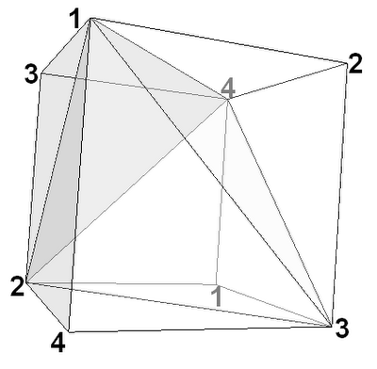
How do we use Geometric Transformations? (1/2)
Objects in a scene at the lowest level are a collection of vertices…
These objects have location, orientation, size
Correspond to transformations: Translation (T), Rotation (R), and Scaling (S)

Slide 3
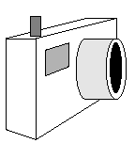
How do we use Geometric Transformations? (2/2)
A scene has a camera/view point from which the scene is viewed
The camera has some location and some orientation in 3D-space …
These correspond to Translation and Rotation transformations
Need other types of viewing transformations as well—we’ll learn about them soon!

Slide 4
Some Linear Algebra Concepts...
3D coordinate geometry
Vectors in 2D space and 3D space
Dot product and cross product—definitions and uses
Vector and matrix notation and algebra
Identity matrix
Multiplicative associativity for matrices
E.g. A(BC) = (AB)C
Matrix transpose and inverse—definition, use, and calculation
Homogeneous coordinates (x, y, z, w)

Slide 5
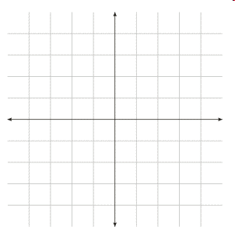
Linear Transformations (1/4)
Vector addition: We represent vectors as bold-italic letters (v) and scalars as italic letters (c)
Head to tail, add components
Multiplying a vector by a scalar changes the vector’s magnitude
Recall that a basis for a vector space is a set of vectors with the following properties:
The vectors in the set are linearly independent
Any vector in the vector space can be expressed as a linear combination of the basis vectors: V = c₁V₁ + c₂V₂
x2
b
a
v
v = a + b
x1
Notes:
Diagram here

Slide 6
Linear Transformations (2/4)
Definition of a linear function/map f - straight line in 2D, hyperplane in n-D
Vector addition: f(v+w) = f(v) + f(w) for all v and w in the domain of f
Scalar multiplication: f(cv) = cf(v) for all scalars c and elements v in the domain
Linear functions can be expressed as (ax₁+bx₂ , cx₁+dx₂)
Example: f(x) = f(x₁ , x₂) := (3x₁+2x₂ , -3x₁+4x₂)
Now let v and w be two elements in the domain of f
f(v+w) = f(v₁+w₁ , v₂+w₂) // by the rule of vector addition
= (3(v₁+w₁)+2(v₂+w₂) , -3(v₁+w₁)+4(v₂+w₂))
= (3v₁+2v₂ , -3v₁+4v₂) + (3w₁+2w₂ , -3w₁+4w₂)
= f(v) + f(w)
Let v = e₁ , w = e₂
We can check the second property (scalar multiplication) the same way
x2
f(e₂)
e₂
e₁+e₂
f(e₁+e₂)
e₁
x1
f(e₁)

Slide 7
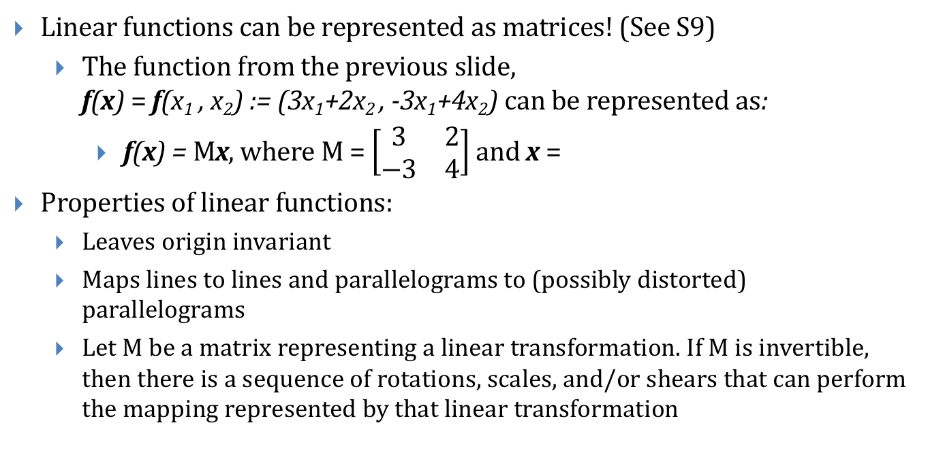
Linear Transformations (3/4)
Linear functions can be represented as matrices! (See S9)
The function from the previous slide, f(x) = f(x₁ , x₂) := (3x₁+2x₂ , -3x₁+4x₂) can be represented as:
f(x) = Mx, where M = $\left[\begin{matrix}3 & 2 \\ −3 & 4\end{matrix}\right]$ and x =
Properties of linear functions:
Leaves origin invariant
Maps lines to lines and parallelograms to (possibly distorted) parallelograms
Let M be a matrix representing a linear transformation. If M is invertible, then there is a sequence of rotations, scales, and/or shears that can perform the mapping represented by that linear transformation

Slide 8
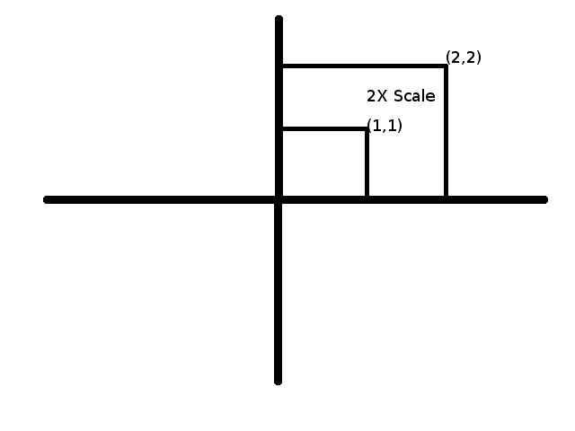
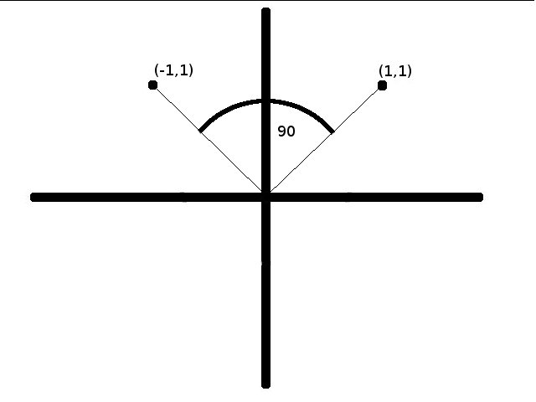
Linear Transformations (4/4)
Graphical use: transformations of points around the origin (leaves the origin invariant)
These include Scaling and Rotations
Translation is not a linear function (moves the origin)
Any linear transformation of a point will result in another point in the same coordinate system, transformed about the origin

Slide 9

Linear Transformations as Matrices (1/2)
Linear transformations can be represented as invertible (non-singular) matrices
Let’s start with 2D transformations. These can be represented by 2x2 matrices:
A transformation of an arbitrary column vector x = has the form:
$$T=\left[\begin{matrix}a & b \\ c & d\end{matrix}\right]$$

Slide 10
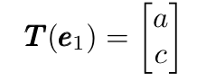
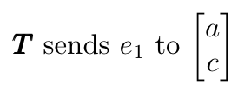
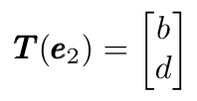
Linear Transformations as Matrices (2/2)
Let e₁ and e₂ be the standard basis vectors:
Now substitute each basis vector for x to get:
Notice that the columns of the matrix representation of our transformation matrix T are precisely T applied to e₁ and e₂:
This gives us a strategy for deriving transformation matrices!
We can derive the columns of a transformation matrix one by one by considering how our desired transformation affects each of the standard unit vectors

Slide 11
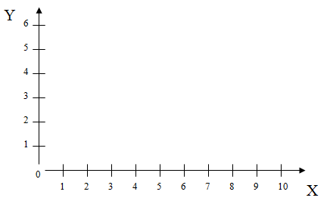

Scaling in 2D (1/2)
Scale x by 3, y by 2 (S_{x} = 3, S_{y} = 2)
v = (original vertex); v’ = (new vertex)
v’ = Sv
Derive S by determining how e₁ and e₂ should be transformed
(scale in X by S_{x})
(scale in Y by S_{y})
Thus we obtain
Side effect: House shifts position relative to origin
Notes:
Do the same for y

Slide 12
Scaling in 2D (2/2)
S is a diagonal matrix; we can quickly check using matrix multiplication that our derivation is correct:
S multiplies each coordinate of v by the appropriate scaling factor, as expected
In general, the i^{th} entry of Dv, where D is diagonal, is (D[i,i] * v[i]), product of two scalars
Properties of scaling to look out for:
Does not preserve angles between lines in the plane (except when scaling is uniform, i.e. s_{x} = s_{y})
If the object doesn’t start at the origin, scaling will move it closer to or farther from the origin (often not desired)

Slide 13
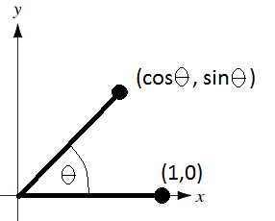
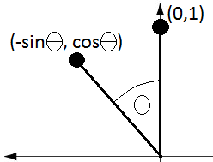
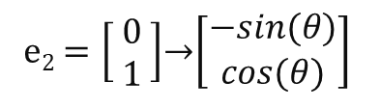
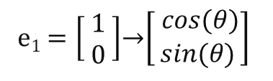
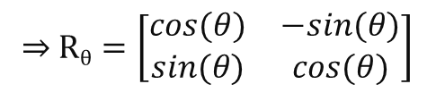
Rotation in 2D (1/2)
Rotate by θ about the origin
v’ = R_{θ}v, where
v = (original vertex)
v’ = (new vertex)
Derive R_{θ} by determining how e₁ and e₂ should be transformed:
e₁$=\left[\begin{matrix} 1 \\ 0\end{matrix}\right]$→$\left[\begin{aligned} cos⁡(θ) \\ sin⁡(θ)\end{aligned}\right]$
(first column of R_{θ})
e₂$=\left[\begin{aligned} 0 \\ 1\end{aligned} \right]$→$\left[\begin{aligned}−sin⁡(θ) \\ cos⁡(θ)\end{aligned}\right]$
(second column of R_{θ})
⇒ R$θ=\left[\begin{matrix}cos⁡(θ) & −sin(θ) \\ sin⁡(θ) & cos⁡(θ)\end{matrix}\right]$

Slide 14


Rotation in 2D (2/2)
Let’s try matrix-vector multiplication
R_{θ}v =
Other properties of rotation:
Preserves lengths in objects and angles between parts of objects (rigid-body rotation)
For objects not centered at the origin, an unwanted translation might be introduced (rotation is always about the origin)
x’ = x cos($θ$) – y sin($θ$)
y’ = x sin($θ$) + y cos($θ$)

Slide 15
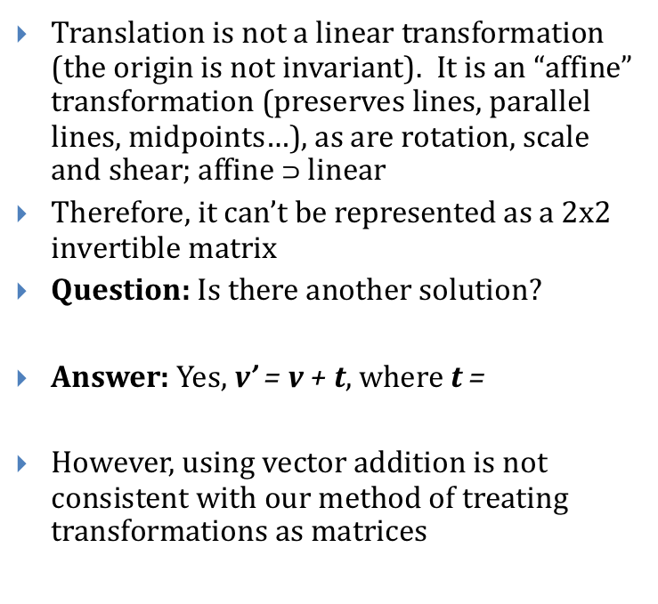
What about translation?
Translation is not a linear transformation (the origin is not invariant). It is an “affine” transformation (preserves lines, parallel lines, midpoints…), as are rotation, scale and shear; affine $⊃$ linear
Therefore, it can’t be represented as a 2x2 invertible matrix
Question: Is there another solution?
Answer: Yes, v’ = v + t, where t =
However, using vector addition is not consistent with our method of treating transformations as matrices
If we could treat all transformations in a consistent manner, i.e., with matrix representation, then could combine transformations by matrix composition
Let’s try using a matrix again
How? Homogeneous Coordinates: add an additional dimension, the w-axis, and an extra coordinate, the w-component
Thus 2D -> 3D (effectively the hyperspace for embedding 2D space)

Slide 16
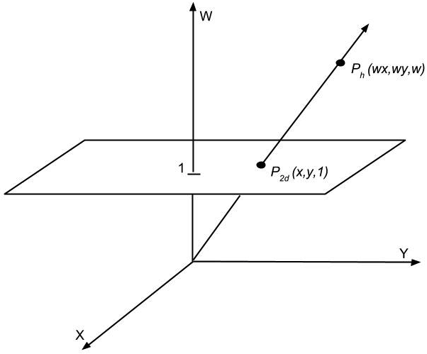
Homogeneous Coordinates (1/3)
Allow expression of all three 2D transformations as 3x3 matrices
We start with the point P_{2d} on the xy plane and apply a mapping to “loft” it to the w-plane in the hyperspace
P_{2d}(x,y) → P_{h}(wx, wy, w), w≠0
The resulting (x’,y’) coordinates in our new point P_{h} are different from the original (x,y), since x’ = wx, y’ = wy
P_{h}(x’, y’, w), w ≠ 0

Slide 17
Homogeneous Coordinates (2/3)
Once we have this point, we can apply a homogenized version of our T, R and S transformation matrices (next slides) to get a new point in the hyperspace
Finally, we want to obtain the corresponding point in 2D-space, so perform the inverse of the previous mapping (divide all entries by w)
The vertex v = is now represented as
v =

Slide 18
Homogeneous Coordinates (3/3)
The transformations we use will always map points in the hyperplane defined by w = 1 to other such points. (That way, we don’t have to divide by w to get our equivalent point in 2D)
In other words, we want our transformations T to map points v = to
points v’ =
How do we achieve this with the matrices we have already derived?
For linear transformations (i.e. scaling and rotation), embed the existing matrix in the upper-left of a new 3x3 matrix:

Slide 19
Back to Translation
Our translation matrix (T) can now be represented by embedding the translation vector in the right column:
To verify that this is the right matrix, multiply it by our homogenized point:
Coordinates have been translated, and v’ is still homogeneous
Notes:
Change T’s

Slide 20



Transformations Homogenized
Let’s homogenize our all matrices! Doesn’t affect linearity of scaling and rotation
Our new transformation matrices look like this…
Note: These transformations are called affine transformations, which means they preserve ratios of distances between points on a straight line (but not necessarily (0, 0) )
Transformation | Matrix
Scaling
Rotation
Translation
$$\left[\begin{matrix}sx & 0 & 0 \\ 0 & sy & 0 \\ 0 & 0 & 1\end{matrix}\right]$$
$$\left[\begin{matrix}cos⁡(θ) & −sin⁡(θ) & 0 \\ sin(θ) & cos⁡(θ) & 0 \\ 0 & 0 & 1\end{matrix}\right]$$
$$\left[\begin{matrix}1 & 0 & dx \\ 0 & 1 & dy \\ 0 & 0 & 1\end{matrix}\right]$$

Slide 21
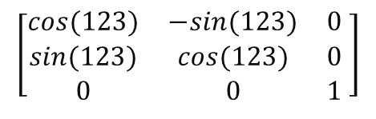


Examples
Scaling: Scale by 15 in the x direction, 17 in the y direction
Rotation: Rotate by 123º
Translation: Translate by -16 in the x direction, +18 in the y direction
$$\left[\begin{matrix}15 & 0 & 0 \\ 0 & 17 & 0 \\ 0 & 0 & 1\end{matrix}\right]$$
$$\left[\begin{matrix}cos⁡(123) & −sin⁡(123) & 0 \\ sin⁡(123) & cos⁡(123) & 0 \\ 0 & 0 & 1 \end{matrix}\right]$$
$$\left[\begin{matrix}1 & 0 & −16 \\ 0 & 1 & 18 \\ 0 & 0 & 1\end{matrix}\right]$$

Slide 22
Before we continue! Vectors vs. Points
Up until now, we’ve only used the notion of a point in our 2D space
We now present a distinction between points and vectors
We used homogeneous coordinates to more conveniently represent translation; hence points are represented as (x, y, 1)^{T}
A vector can be rotated/scaled, but not translated (can think of it as always starting at origin)

Slide 23
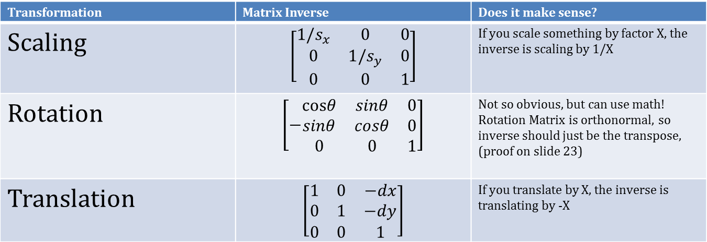
Inverses
When we want to undo a transformation, we’ll need to find the matrix’s inverse.
Thanks to homogenization, they are all invertible!
Transformation | Matrix Inverse | Does it make sense?
Scaling |  | If you scale something by factor a, the inverse is scaling by 1/a
Rotation |  | Inverse of rotation by θ is rotation by –θ. The properties sin(-θ) = -sin(θ) and cos(-θ) = cos(θ) give this matrix. Also, the matrix is orthonormal, so inverse is just the transpose (see next slide).
Translation |  | If you translate by x, the inverse is translation by -x

Slide 24
Composition of Transformations (2D) (1/2)
We now have a number of tools at our disposal; we can combine them!
An object in a scene uses many transformations in sequence. How do we represent this in terms of functions?
Transformation is a function; by associativity, we can compose functions:
(f o g)( i )
This is the same as first applying g, then applying f:
f( g( i ) )
Consider our functions f and g as matrices (M₁ and M₂) and our input as a vector v
Our composition is equivalent to M₁M₂v

Slide 25
Composition of Transformations (2D) (2/2)
We can now form compositions of transformation matrices to form a more complex transformation
For example, TRSv, which scales a point, then rotates it, then translates it:
Note that we apply the matrices in sequence right to left. We can use associativity to compose them first; it is often useful to be able to apply a single matrix if, for example, we want to use it to transform many points at once
Important: order matters! Matrix multiplication is NOT commutative.

Slide 26
Transformations in General are not Commutative
6
Translate by
x = 6, y = 0, then
rotate by 45º
5
4
3
2
1
0
1
2
3
4
5
6
7
8
9
10
Rotate by 45º,
then translate
by x = 6, y = 0
Y
6
5
4
3
2
1
0
1
2
3
4
5
6
7
8
9
10
X

Slide 27
Composition (an example) (2D) (1/2)
-Rotate 90º
-Uniform scale 4x
-Both around object’s
center, not the origin
Start: Goal:
Important concept: make the problem simpler
Translate object to origin first, scale, rotate, and translate back:
Apply to all vertices

Slide 28

Composition (an example) (2D) (2/2)
T⁻¹RST
But what if we mixed up the order? Let’s try RT⁻¹ST:
Oops! We scaled properly, but when we rotated the object, it’s center was not at the origin, so its position was shifted. Order matters!

Slide 29
Skewing/shearing
“Skew” an object to the side, like shearing a card deck by displacing each card relative to the previous one
A transformation that slants the shape of an object is called the shear transformation. In 2D, there are two shear transformations X-Shear and Y-Shear. One shifts X coordinates values and other shifts Y coordinate values. However; in both the cases only one coordinate changes its coordinates and other preserves its values. Shearing is also termed as Skewing.
Notes:
Size of matrix

Slide 30
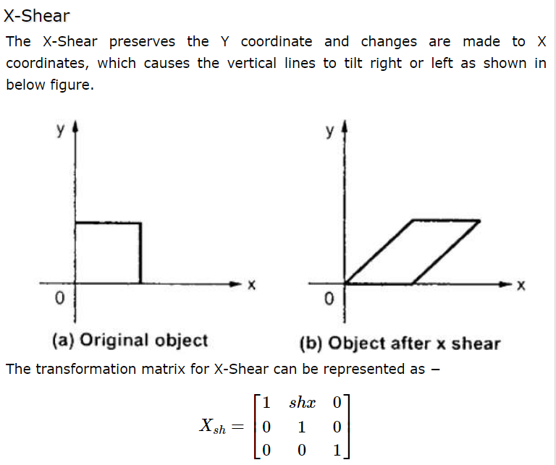
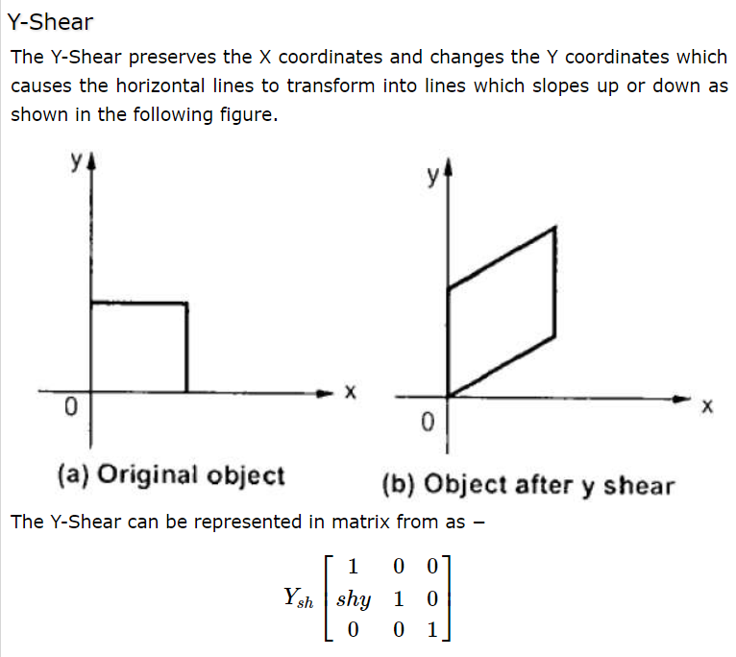
Skewing/shearing
Notes:
Size of matrix

Slide 31
Inverses Revisited
What is the inverse of a sequence of transformations?
(M₁M₂…M_{n})⁻¹ = M_{n}⁻¹M_{n-1}⁻¹…M₁⁻¹
Inverse of a sequence of transformations is the composition of the inverses of each transformation in reverse order (why?)
Say we want to do the opposite transformation of the example on slide 27 What will our sequence look like?
(T⁻¹RST)⁻¹ = T⁻¹S⁻¹R⁻¹T
We still translate to the origin first, then translate back at the end!

Slide 32
Aside: Transforming Coordinate Axes
We understand linear transformations as changing the position of vertices relative to the standard axes
Can also think of transforming the coordinate axes themselves
Just as in matrix composition, be careful of which order you modify your coordinate system!
Rotation
Scaling
Translation

Slide 33
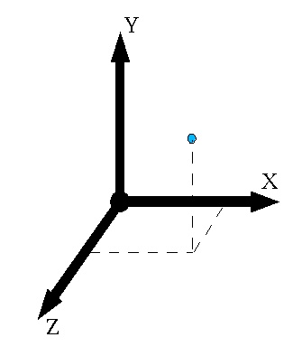
Dimension++ (3D!)
How should we treat geometric transformations in 3D?
Just add one more coordinate/axis!
A point is represented as
A matrix for a linear transformation T can be represented as
where e₃ is the standard basis vector along the z-axis,
But remember to use homogeneous coordinates! Embed scale and rotation matrices as upper left submatrices and translation vectors as upper right subvectors of the right column

Slide 34
Transformations in 3D
Transformation | Matrix | Comments
Scaling |  | Looks just like the 2D version. We just added an s_{z} term.
Rotation | (see next slide) | In 2D, only one axis of rotation; now there are infinitely many! Must take all into account. See next slide...
Translation |  | Similar to the 2D version, just with one more entry dz, representing change in the z-direction.

Slide 35
Rodrigues’s Formula…
Rotation by angle θ around vector u = [u_{x} u_{y} u_{z}]^{T}
Note: this is an arbitrary unit vector u in xyz-space
Here’s a not so friendly-looking rotation matrix
This is called the coordinate form of Rodrigues’s formula
Let’s try a different approach…

Slide 36
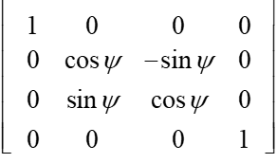
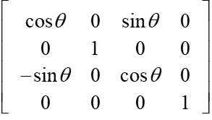
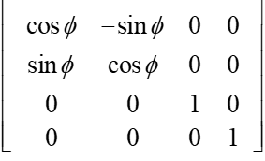
Rotating axis by axis (1/2)
Every rotation can be represented as the composition of 3 different angles of counter-clockwise rotation around 3 axes, namely
x axis in the yz plane by ψ; y axis in the xz plane by θ; z axis in the xy plane by ϕ
Also known as Euler angles, make problem of rotation much easier
Note these differ only in how the 3x3 submatrix is embedded in the homogeneous matrix, but the row-column order is different for R_{zx}
You can compose these matrices to form a composite rotation matrix
R_{yz}(ψ): rotation about x axis by ψ | R_{zx}(θ): rotation about y axis by θ | R_{xy}(ϕ): rotation about z axis by ϕ
Notes:
italic

Slide 37
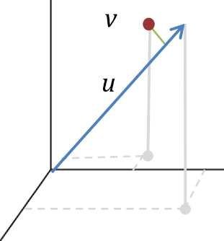
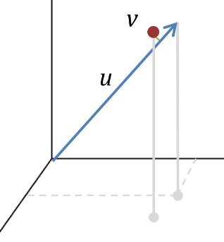
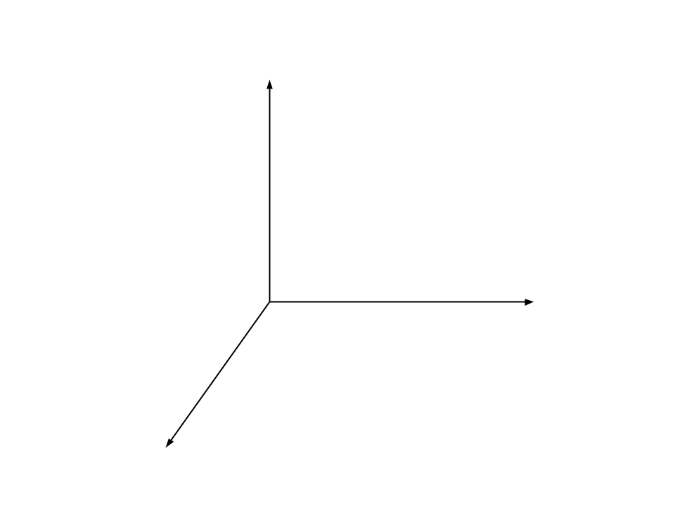
Rotating axis by axis (2/2)
It would still be difficult to find the 3 angles to
rotate by, given arbitrary axis u and specified angle ψ
Solution? Make the problem easier by
mapping u to one of the principal axes
Step 1: Find a θ to rotate around y axis
to put u in the xy plane
Step 2: Then find a ϕ to rotate around
the z axis to align u with the x axis
(Now that u is in a convenient alignment, we can do our transformation rotation for vertex v!)
Step 3: Rotate v by ψ around x axis (which is coincident with u axis)
Step 4: Finally, undo the alignment rotations (inverse)
The only rotation we’ve preserved is the one around axis u by ψ, which was our goal
Rotation matrix: M = R_{zx}⁻¹(θ)R_{xy}⁻¹(ϕ)R_{yz}(ψ)R_{xy}(ϕ)R_{zx}(θ)
Before: v is in the back quadrant
After: v is in the front quadrant
y
θ
v
v
u
v
ψ
u
v
x
ϕ
z

Slide 38
Inverses and Composition in 3D!
Inverses are once again parallel to their 2D versions…
Composition works exactly the same way…
Transformation | Inverse Matrix
Scaling
Rotation | R_{yz}⁻¹ (ψ) R_{zx}⁻¹(θ) R_{xy}⁻¹(ϕ)
Translation

Slide 39
Example in 3D!
Let’s take some 3D object, say a cube centered at (2,2,2)
Rotate clockwise in object’s space by 30º around x axis, 60º around y, and 90º around z
Scale in object space by 1 in the x, 2 in the y, and 3 in the z
Translate by (2,2,4) in world space
Transformation sequence: TT₀⁻¹S_{xy}R_{xy}R_{zx}R_{yz}T_{o}, where T₀ translates to (0,0):
T T₀⁻¹ S_{xy} R_{xy} R_{zx} R_{yz} T₀

Slide 40
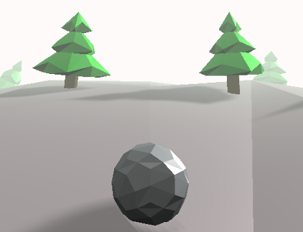
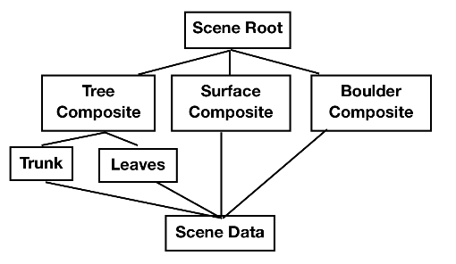
Transformations and the scene graph (1/5)
Scene Graph
Objects are typically composites:
3D scenes are often stored in a directed acyclic graph (DAG) called a scene graph
WPF (Windows Presentation Foundation)
Open Scene Graph (used in the Cave)
X3D ™ (VRML ™ was a precursor to X3D)
most game engines
Typical scene graph format:
objects (cubes, sphere, cone, polyhedra etc.):
stored as nodes (default: unit size at origin)
attributes (color, texture map, etc.): stored as separate nodes
Transformations: also nodes
ROBOT
upper body
lower body
stanchion
base
head
trunk
arm
arm
Example scenegraph from a game engine

Slide 41
Transformations and the scene graph (2/5)
Simplified format:
Attributes stored as a component of each object node (no separate attribute node)
A transform node affects its subtree
Only leaf nodes are graphical objects.
All internal nodes that are not transform nodes are object group nodes

Slide 42
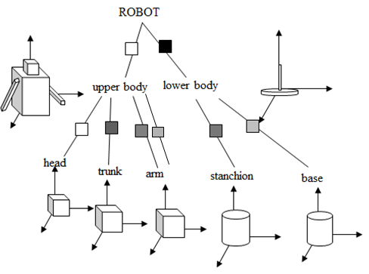
Transformations and the scene graph (3/5)
Step 1: Various transformations are applied to each of the leaves (object primitives—head, base, etc.)
Step 2: Transformations are then applied to groups of objects (form upper and lower body, etc…)
This format means that instead of designing new primitives for every single shape we need, we can just apply transformations to a smaller set of primitives to form complex composite 3D shapes
Represents a
transformation
Together the above hierarchy of transformations forms the “robot” scene as a whole

Slide 43
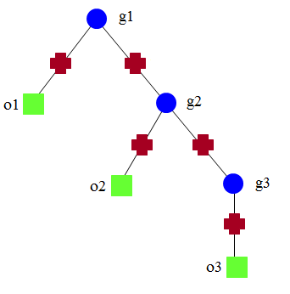
Transformations and the scene graph (4/5)
A cumulative transformation matrix (CTM) builds as you move up the tree
Note that higher level transformation matrices are appended to the front of the sequence
Example:
For object 1 (o1), CTM = M₁
For o2, CTM = M₂M₃
For o3, CTM = M₂M₄M₅
For a vertex v in o3, position in world coordinate system is CTM v = (M₂M₄M₅) v
M₁
M₂
M₃
M₄
M₅
object nodes (geometry)
transformation nodes
group nodes

Slide 44
Transformations and the scene graph (5/5)
You can easily reuse groups of objects (sub-trees in the scene graph) if they have been defined already
This might occur if you have multiple similar components to your scene. For example, the robot’s 2 arms
Here, group 3 has been used twice.
Transformations defined within group 3 itself do not change; there are different CTMs for each use of group 3 as a whole
T₀T₁ vs. T₀T₂T₄
root
group3
group1
obj4
obj3
obj1
group3
group2
obj2
group3

